Slide 1
CREATING A NO-BUDGET SHORT FILM
Jaroslav Maléř
2022
UTB SHOW-OFF
UTB SHOW-OFF
My project presentation

Slide 2
Well, I wanted to make a movie.
Jaroslav Maléř
2022

Slide 3
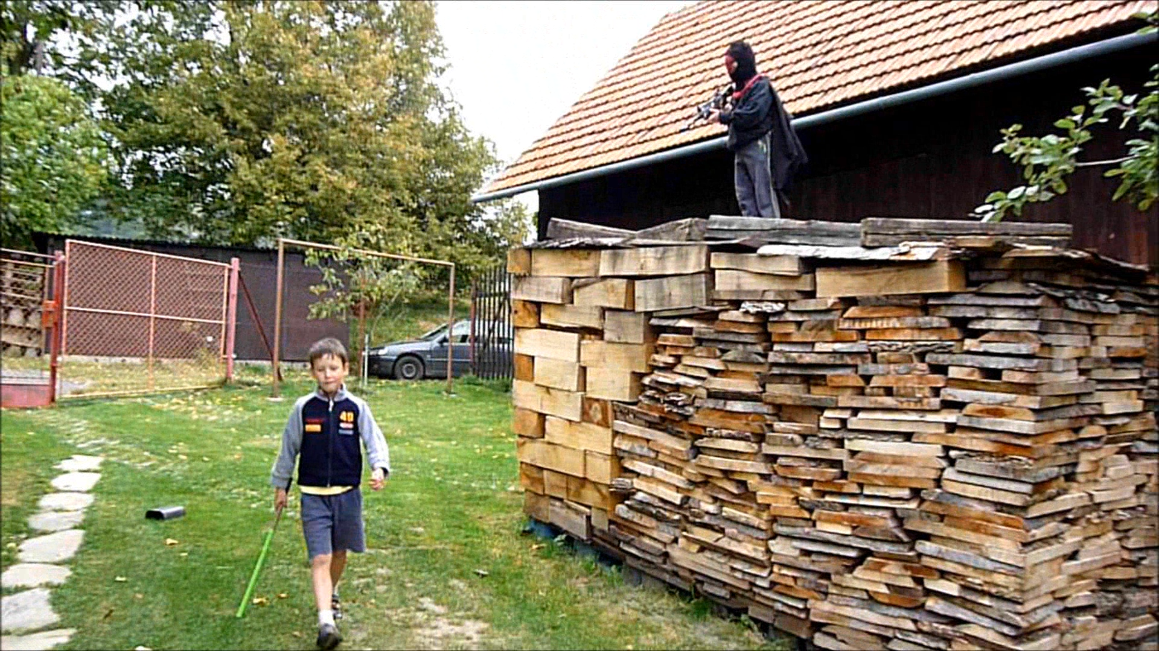
Jaroslav Maléř
2022
I have already made
a „movie“ 10 years ago

Slide 4
I will now take you on a journey through the process of what it takes to create a no-budget short movie.
Jaroslav Maléř
2022

Slide 5
Jaroslav Maléř
2022
THE FILMMAKING PROCESS
Is divided into 3 main parts:
PRE-PRODUCTION
MOVIE-PRODUCTION
POST-PRODUCTION
Everything needs to be planned and scheduled.
Actors come in and the movie is shot
The footage is put together to
create a motion picture

Slide 6
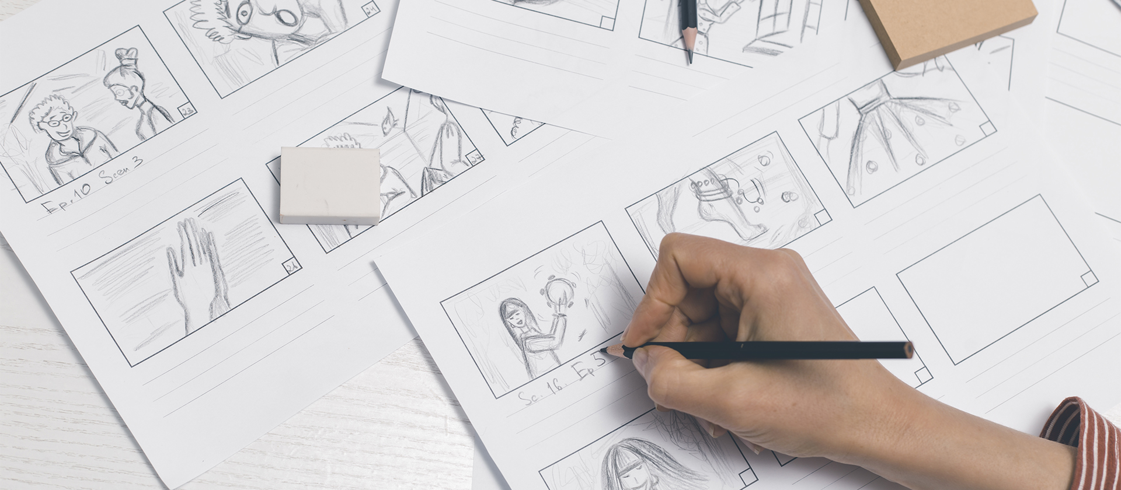
01
PRE PRODUCTION
Jaroslav Maléř
2022

Slide 7
Jaroslav Maléř
2022
IDEA

Slide 8
Jaroslav Maléř
2022
Pre-production essentials
What?
Who?
Where?
How?
The story
The characters
The environment
The look of the movie
Screenplay
Actors or Actresses
Locations
Filmmaking gear

Slide 9
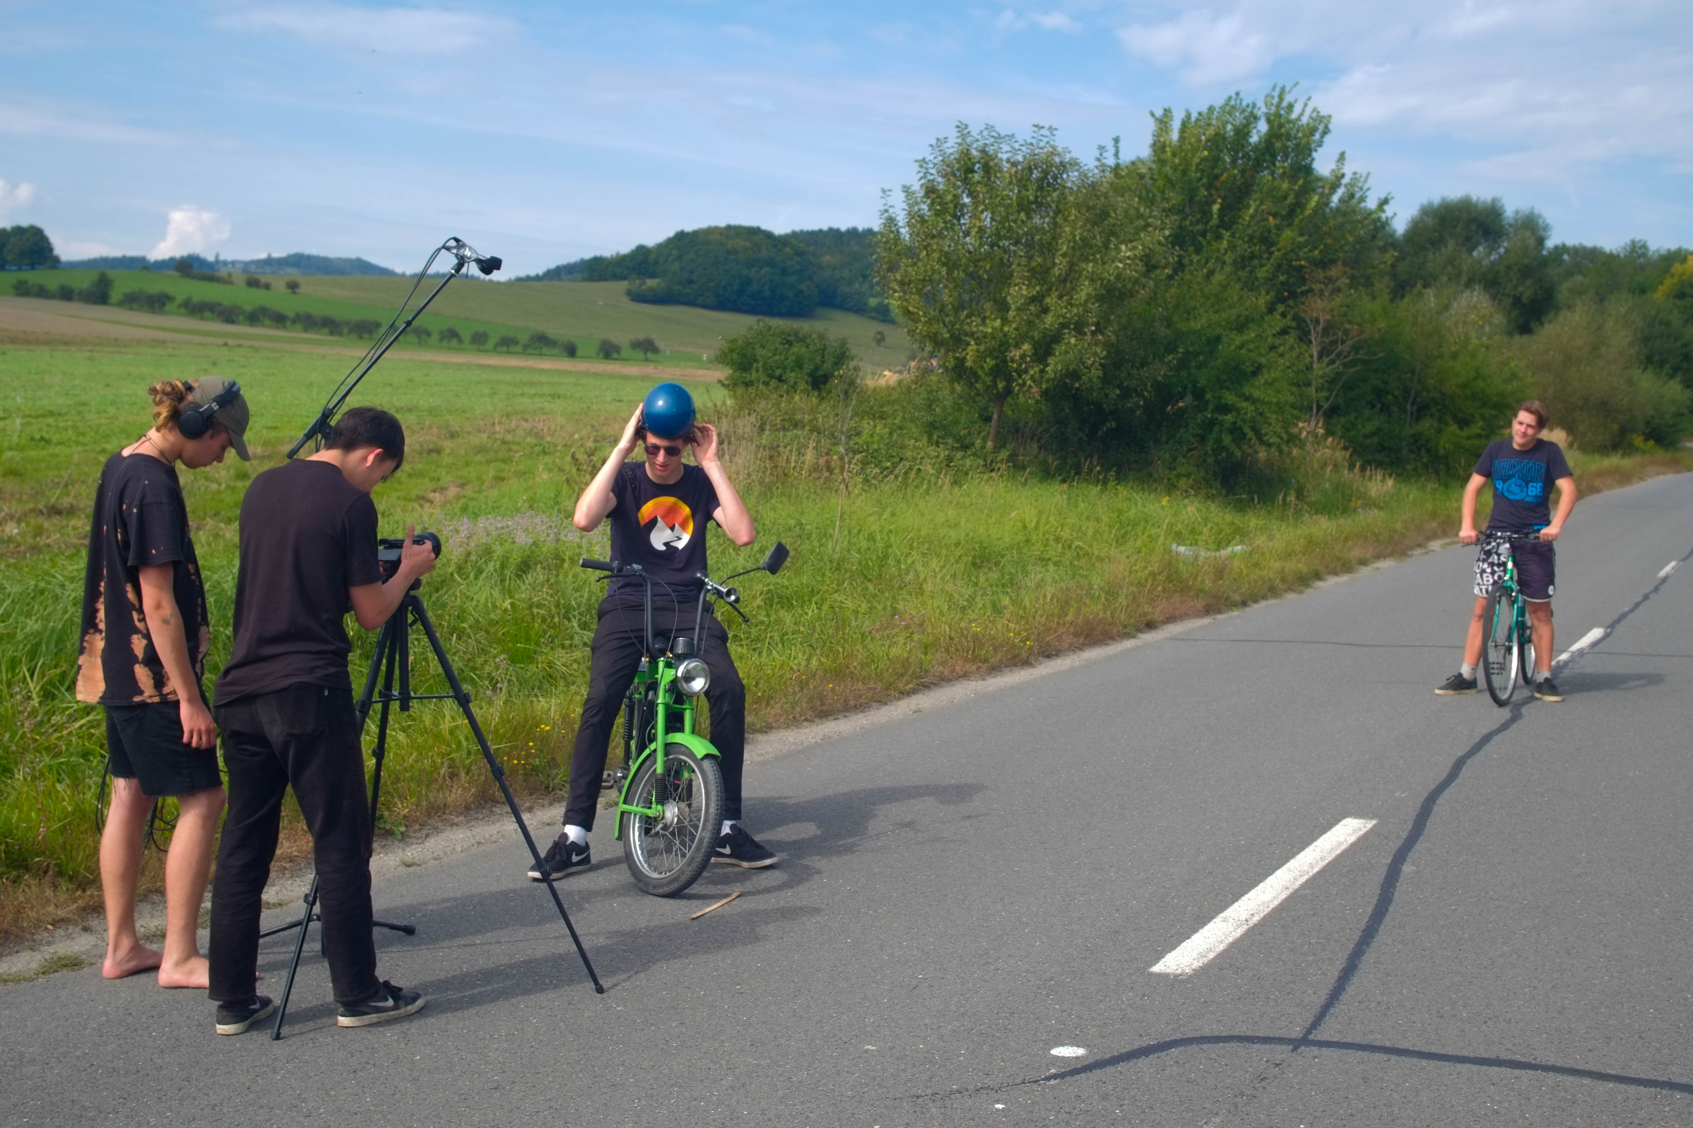
Jaroslav Maléř
2022
02
MOVIE PRODUCTION

Slide 10
Jaroslav Maléř
2022
Essential roles
- Film Producer
- Director
- Cinematographer
- Sound Engineer
- Runner

Slide 11
Jaroslav Maléř
2022
Struggles
The weather
Gear problems
Stress
Being behind
the schedule
Multiple takes

Slide 12
Improvise
Jaroslav Maléř
2022

Slide 13
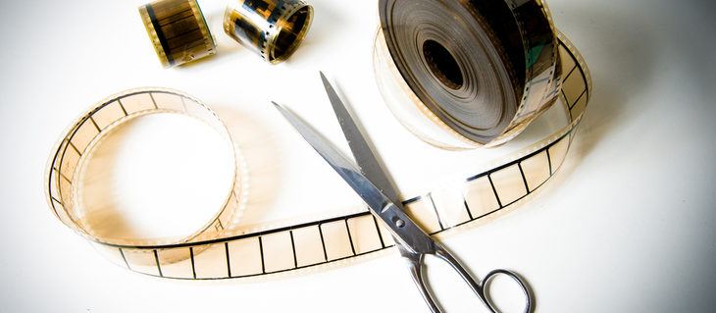
03
POST PRODUCTION
Jaroslav Maléř
2022

Slide 14
Jaroslav Maléř
2022
THE POST PRODUCTION MACHINE
Footage sorting
Editing
Audio Effects
Sound mixing
Visual Effects
Color-Grading

Slide 15
Jaroslav Maléř
2022
The ones “living inside the machine”
- Film Editor
- Sound engineer
- Visual effects artist
- Colorist

Slide 16
Make stuff that is interesting to you.
Jaroslav Maléř
2022

Slide 17
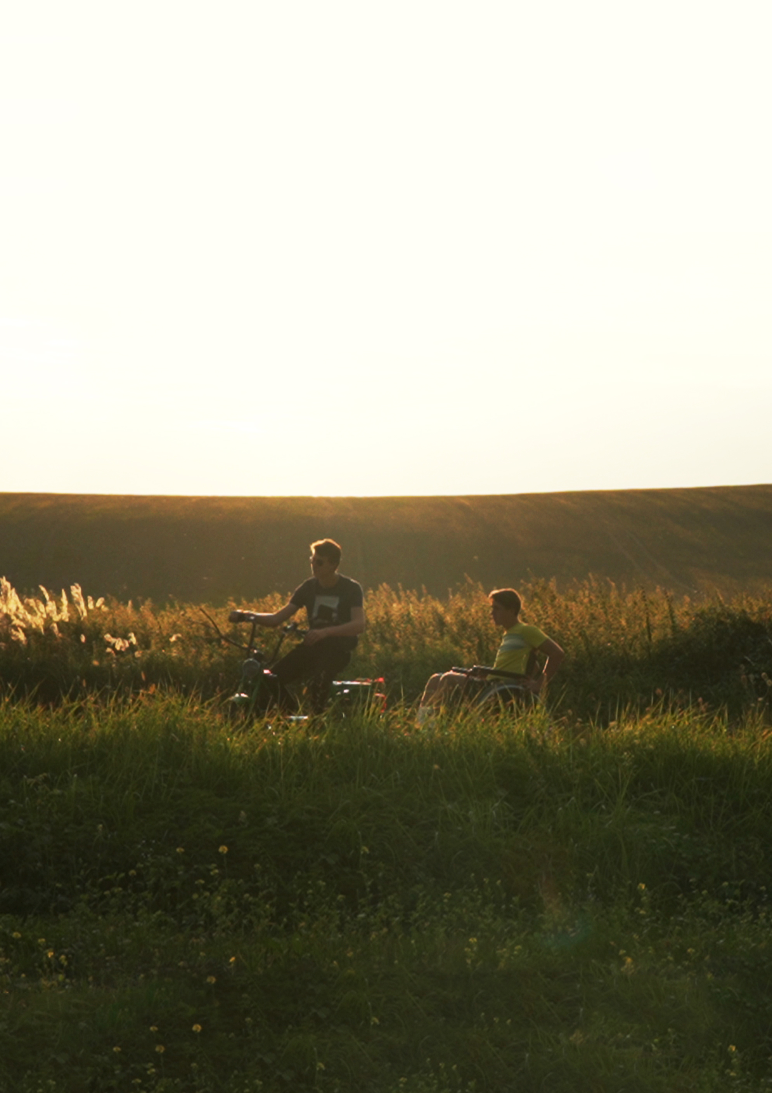
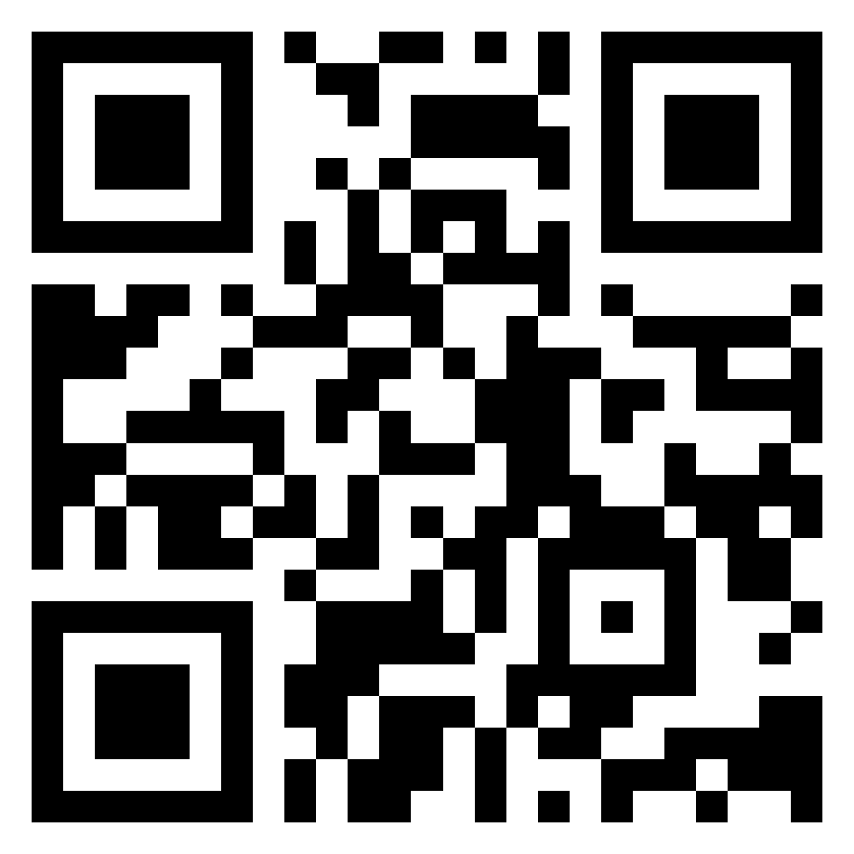
THANKS!
Jaroslav Maléř
2022
DO YOU HAVE ANY QUESTIONS?
You can watch my movie
(in Czech or with
English subtitles)
by scanning this QR code:

